Slide 1
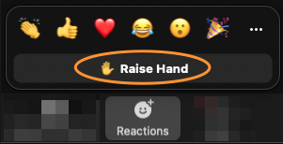
Feedback
Your Feedback is important to us to shape our training and certification program.
https://pages.aviatrix.com/ace-professional-survey.html
Raise hand in Zoom when done
Notes:
Your Feedback is very important to us. If you wanna say something on what we could improve. I really appreciate if you can fill out the survey. Your feedback will be very meaningful. I am gonna give two/three minutes.
If you can raise yoru hand when you are done it would be great. Of course, it is not mandatory, we just appreciate to know what was good and what was not.
https://forms.office.com/r/vhyhpCFj6t

Slide 2

Next Steps → ACE Automation Specialty (IaC)
Sign up for ACE Multicloud Network Automation Specialty (IaC)
https://ace.aviatrix.com/ace-iac
Use coupon code freeaceproattendees - 100% cost free
About this course:
The Aviatrix Certified Engineer Multicloud Network Infrastructure as Code (IaC) course brings the concepts of DevOps together by automating a multicloud network infrastructure through hands-on labs.
The training includes solved walkthrough guides of each lab. Students can expect to enter the training with no coding background and complete the training with an understanding of how to use IaC tools (GitHub and Terraform Cloud) to build, enhance, and secure multicloud networks at scale in an automated fashion.
Notes:
ACE Automation (IaC) training → https://ace.aviatrix.com/ace-iac
Coupon code – 100% free cost → freeaceproattendees

Slide 3

ACE-Professional Exam Guidelines
Close all unnecessary programs and browsers/tabs, except the one tab being used for taking exam. Chrome required!
Once exam is started, stay in the same browser through out the exam, don’t navigate away!
Please act as if you are sitting in a testing center where you are not allowed to use any resources, talk, or ask questions.
You are not allowed to discuss test questions with anyone, and Aviatrix reserves the right to revoke your certification in case of taking screenshots or sharing the content of the exam.
Your activity is being monitored during the exam and will be validated before result is announced
NO EXCUSE FOR CHEATING

Slide 4
Prerequisites
All labs must be 100% completed except bonus labs.
Install Proctorio Plugin by going to https://getproctorio.com and confirming you met all the requirements.
System requirements for taking the exam:
Chrome Browser
Permissions to install plugins
Working Microphone (NO HEADPHONES ALLOWED)
Working Webcam
Government-Issued ID
Verify your system compatibility at https://getproctorio.com
Your screen, camera, speaker, microphone, and system activity will be monitored and recorded during the exam. If you do not agree to these terms and conditions, please do not take the exam.
If you get kicked out, please re-enter the exam ASAP. The clock is still ticking.

Slide 5
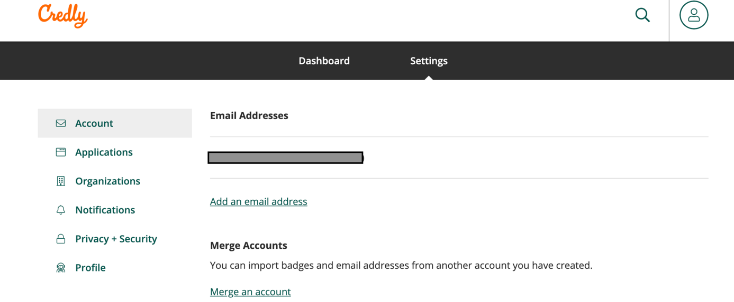
Importing badges from a different account
Credly → Merge an Account Option

Slide 6
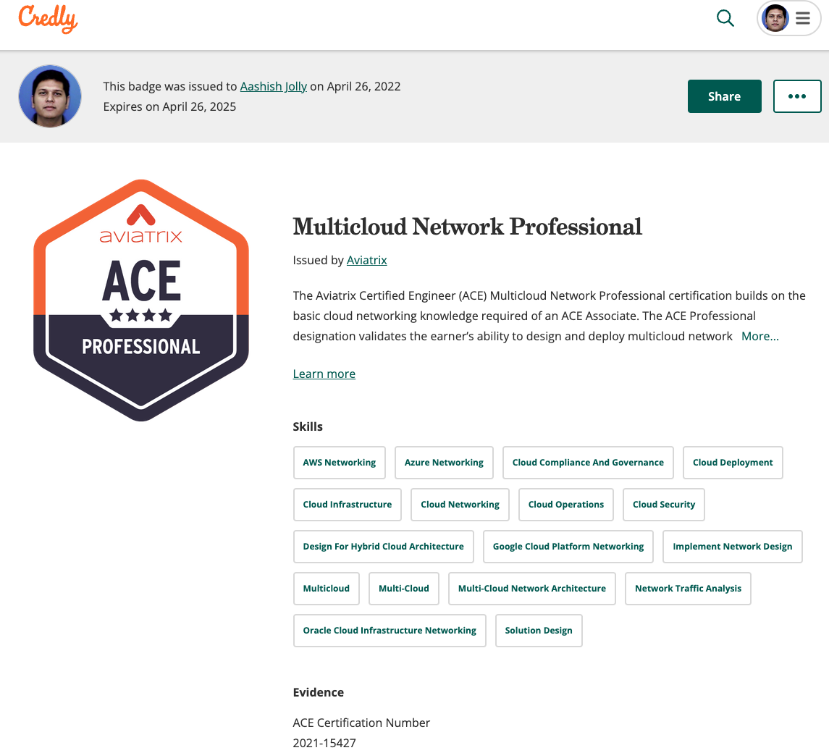

Digital Badge

Slide 7


